Slide 1
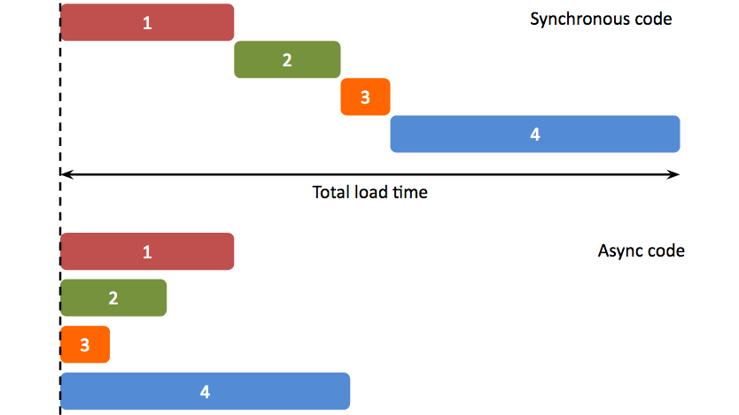
Asynchronous programming

Slide 2


Slide 3
Ważne:
Main queue is serial, first in first out
Wszystkie funkcje UIKit muszą być wykonywane przez main thread

Slide 4
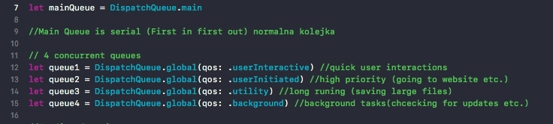
Quality of service, priorytet kolejek

Slide 5
Sync vs Async
Sync - Run some task synchronously (i.e. the thread which can be main/global/any other thread will wait for the task to complete)
Async - Run some task asynchronously (i.e. the thread which can be main/global/any other thread will push the task to a queue and continue executing next steps outside your block. It wont wait)
DispatchQueue.main.async
-It means performing task in main queue with using of background thread (w/o blocking of UI) and when task finish it automatic Updated to UI because its already in Main Queue.

Slide 6
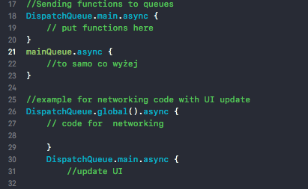
Sending functions to queues

Slide 7
Dispatch Group

Slide 8
Dispatch Time
Struct used with Dispatch methods, for example with
asyncAfter(deadline: DispatchTime execute: dispatchWork)

Slide 9
Kochanie
Kup chleb tostowy, pieprz i parówki. Kocham Cie i czekam w domu!

Slide 10
Useful links
https://www.youtube.com/watch?v=lOI0aUkeuLw śmieszny murzyn (tutorial, dispatch group )
Quality of Service explained
https://developer.apple.com/documentation/dispatch << top link

Slide 11
NSOperationQueue
NSOperationQueues are built on top of GCD and allow you to “link” different operations together to form a complex dependency graph.
https://developer.apple.com/documentation/foundation/nsoperationqueue
https://www.raywenderlich.com/76341/use-nsoperation-nsoperationqueue-swift

